Slide 1
MODULE 5

Slide 2
AUTOENCODERS
Autoencoders are a specific type of feedforward neural networks where the input is the same as the output.
They compress the input into a lower-dimensional code and then reconstruct the output from this representation.
The code is a compact “summary” or “compression” of the input, also called the latent-space representation.
An autoencoder consists of 3 components: encoder, code and decoder.
The encoder compresses the input and produces the code, the decoder then reconstructs the input only using this code.

Slide 3
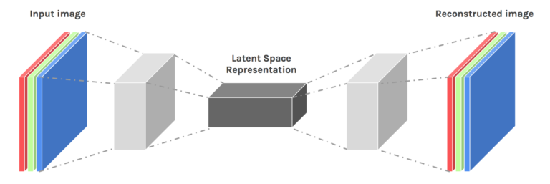
An autoencoder neural network is an Unsupervised Machine learning algorithm that applies backpropagation, setting the target values to be equal to the inputs.
Autoencoders are used to reduce the size of our inputs into a smaller representation.
If anyone needs the original data, they can reconstruct it from the compressed data.

Slide 4
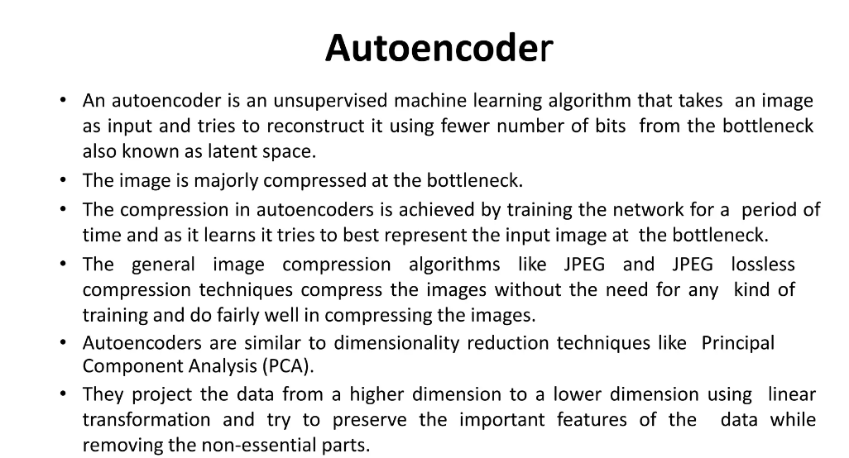

Slide 5
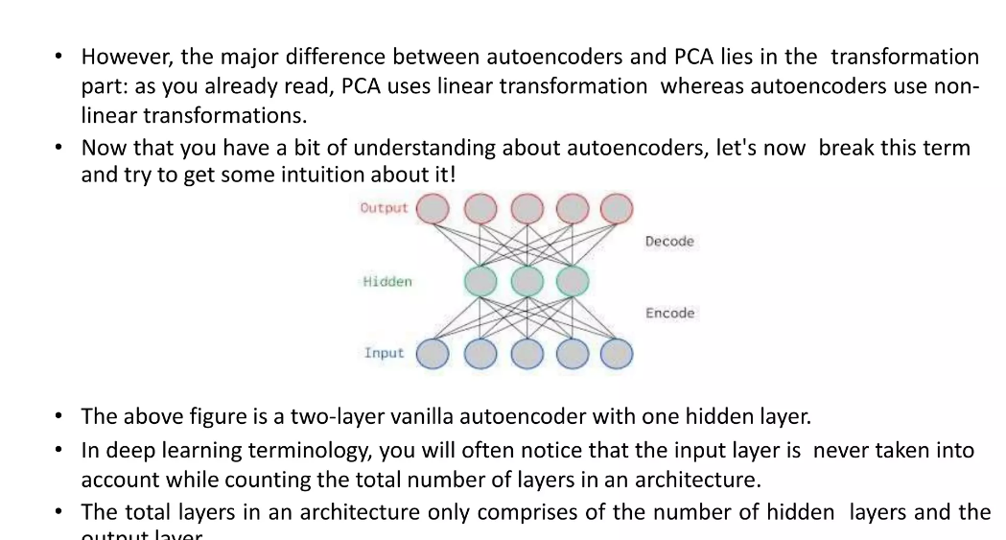

Slide 6
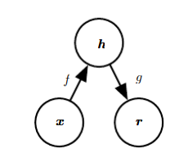
An autoencoder is a neural network that is trained to attempt to copy its input to its output.
Internally, it has a hidden layer h that describes a code used to represent the input.
The network may be viewed as consisting of two parts: an encoder function h = f (x) and a decoder that produces a reconstruction r = g(h)

Slide 7
The general structure of an autoencoder, mapping an input x to an output (called reconstruction) r through an internal representation or code h.
The autoencoder has two components: the encoder f (mapping x to h) and the decoder g (mapping h to r).

Slide 8
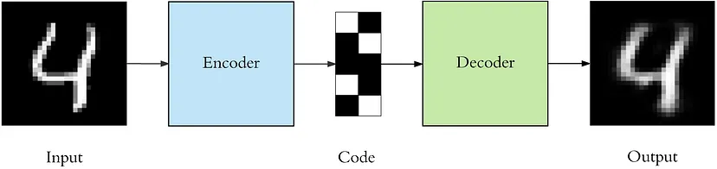

Slide 9
To build an autoencoder we need 3 things: an encoding method, decoding method, and a loss function to compare the output with the target.
Autoencoders are mainly a dimensionality reduction (or compression) algorithm with a couple of important properties:

Slide 10
Data-specific: Autoencoders are only able to meaningfully compress data similar to what they have been trained on. Since they learn features specific for the given training data, they are different than a standard data compression algorithm like gzip. So we can’t expect an autoencoder trained on handwritten digits to compress landscape photos.
Lossy: The output of the autoencoder will not be exactly the same as the input, it will be a close but degraded representation.
Unsupervised:utoencoders are considered an unsupervised learning technique since they don’t need explicit labels to train on. But to be more precise they are self-supervised because they generate their own labels from the training data.

Slide 11
Architecture
Both the encoder and decoder are fully-connected feedforward neural networks.
Code is a single layer of an ANN with the dimensionality of our choice. The number of nodes in the code layer (code size) is a hyperparameter that we set before training the autoencoder.

Slide 12
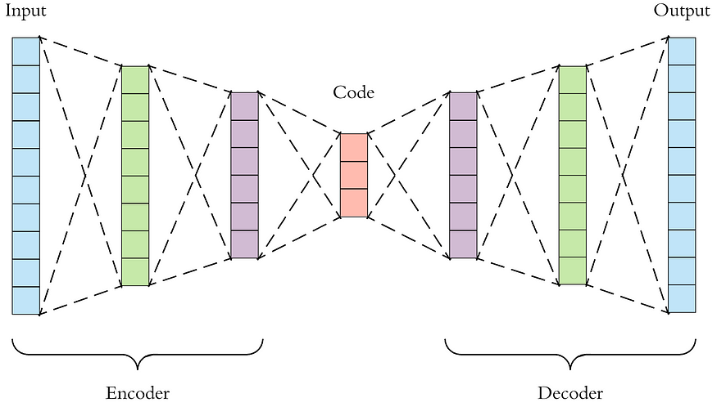

Slide 13
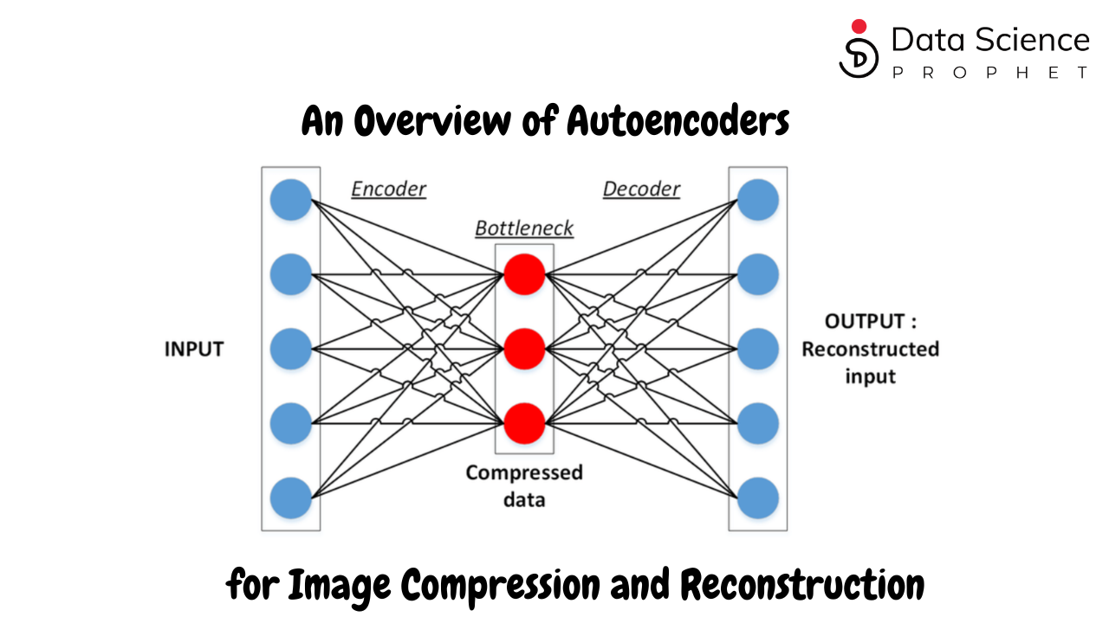

Slide 14
First the input passes through the encoder, which is a fully-connected ANN, to produce the code.
The decoder, which has the similar ANN structure, then produces the output only using the code.
The goal is to get an output identical with the input.
Note that the decoder architecture is the mirror image of the encoder.
The only requirement is the dimensionality of the input and output needs to be the same.

Slide 15
There are 4 hyperparameters that we need to set before training an autoencoder:
Code size: number of nodes in the middle layer. Smaller size results in more compression.
Number of layers: the autoencoder can be as deep as we like. In the figure above we have 2 layers in both the encoder and decoder, without considering the input and output.

Slide 16
Number of nodes per layer: the autoencoder architecture we’re working on is called a stacked autoencoder since the layers are stacked one after another.
Usually stacked autoencoders look like a “sandwitch”.
The number of nodes per layer decreases with each subsequent layer of the encoder, and increases back in the decoder.
Also the decoder is symmetric to the encoder in terms of layer structure.

Slide 17
Loss function: we either use mean squared error (mse) or binary crossentropy. If the input values are in the range [0, 1] then we typically use crossentropy, otherwise we use the mean squared error.
Autoencoders are trained the same way as ANNs via backpropagation.

Slide 18
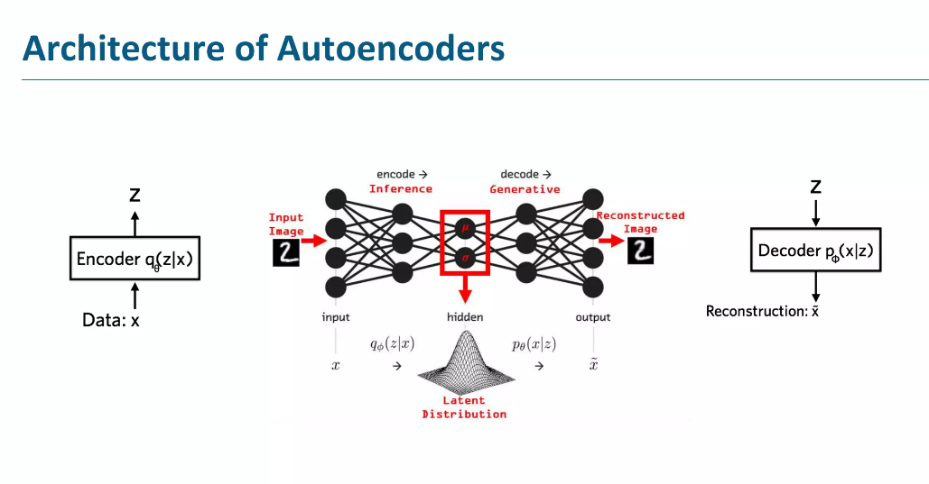

Slide 19
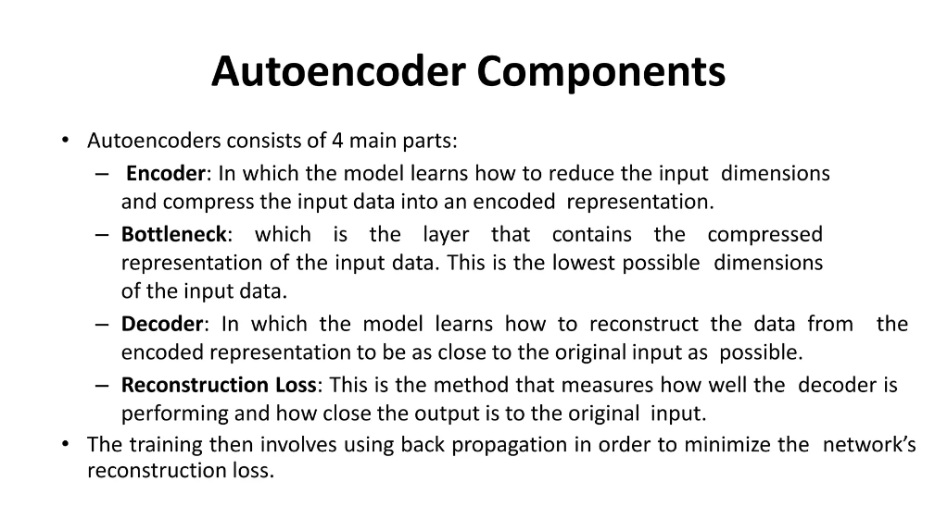

Slide 20
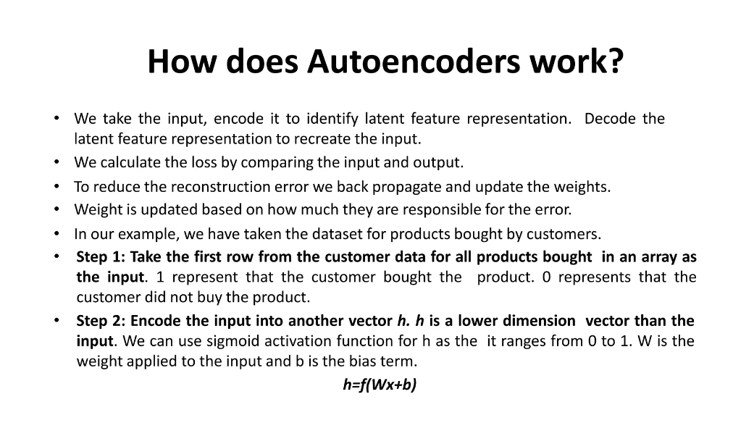

Slide 21
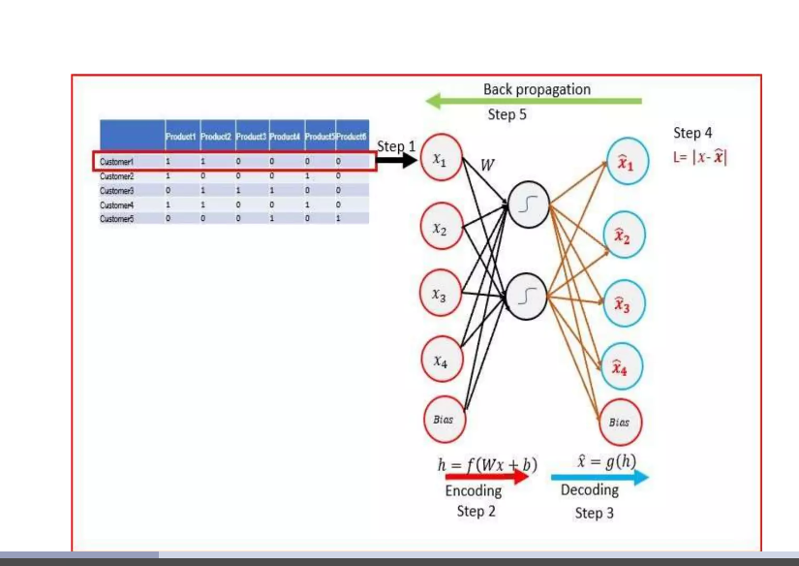

Slide 22
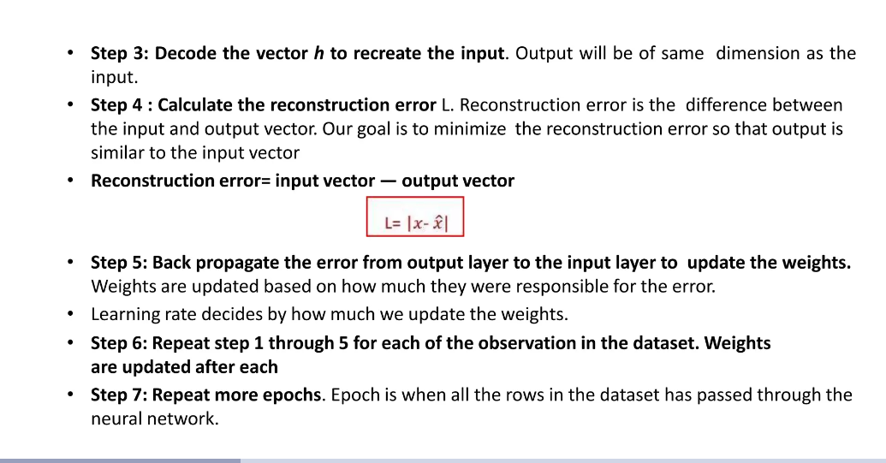

Slide 23
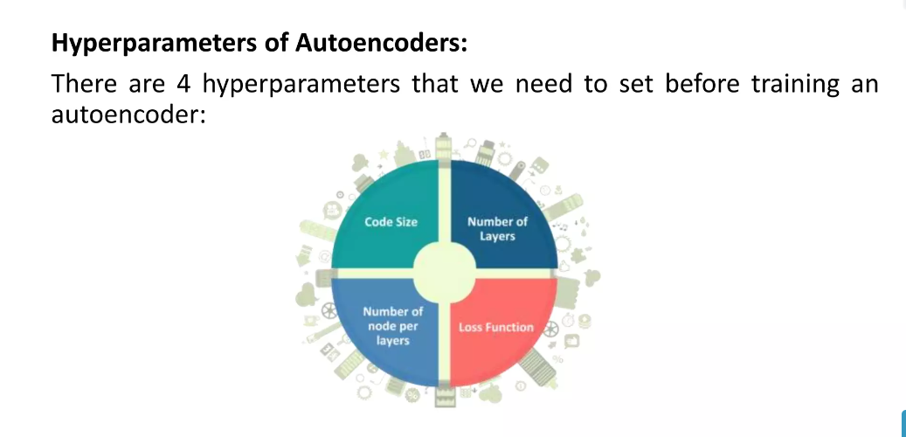

Slide 24
Types of autoencoders
Convolutional Autoencoder: Convolutional Autoencoders(CAE) learn to encode the input in a set of simple signals and then reconstruct the input from them.
Variational Autoencoders: This type of autoencoder can generate new images just like GANs.
Denoising autoencoders: Denoising autoencoders add some noise to the input image and learn to remove it.
Deep autoencoders: A deep autoencoder is composed of two symmetrical deep-belief networks having four to five shallow layers.

Slide 25
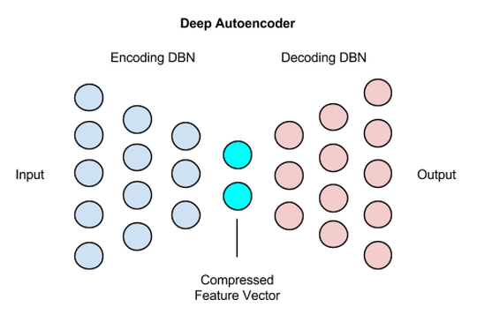
Deep Autoencoders
First four or five shallow layers representing the encoding half of the net.
The second set of four or five layers that make up the decoding half.

Slide 26
Application of autoencoders
Data Compression
Although autoencoders are designed for data compression yet they are hardly used for this purpose in practical situations. The reasons are:
Lossy compression: The output of the autoencoder is not exactly the same as the input, it is a close but degraded representation. For lossless compression, they are not the way to go.
Data-specific: Autoencoders are only able to meaningfully compress data similar to what they have been trained on.

Slide 27
Image Denoising
Autoencoders are very good at denoising images. When an image gets corrupted or there is a bit of noise in it, we call this image a noisy image.
To obtain proper information about the content of the image, we perform image denoising.

Slide 28
Dimensionality Reduction
Dimensionality Reduction
The autoencoders convert the input into a reduced representation which is stored in the middle layer called code. This is where the information from the input has been compressed.
Feature Extraction
Encoding part of Autoencoders helps to learn important hidden features present in the input data, in the process to reduce the reconstruction error

Slide 29
Image colourisation
One of the applications of autoencoders is to convert a black and white picture into a coloured image. Or we can convert a coloured image into a grayscale image.
Image Compression
Image compression is one application where autoencoders might be helpful. By training an autoencoder on a large dataset of images, the model can learn to identify the essential elements of the image and compress it into a smaller representation while retaining high image quality

Slide 30
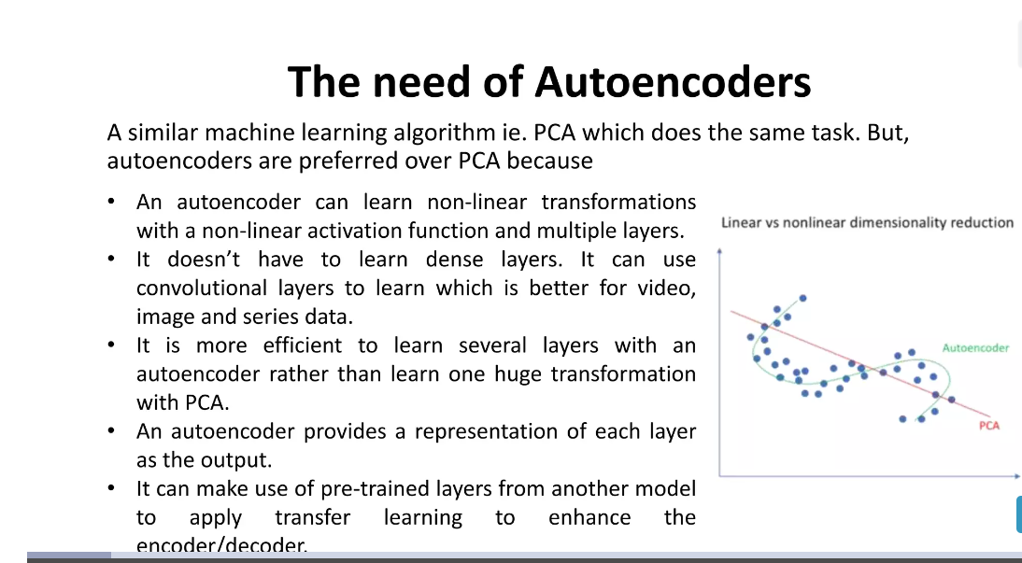

Slide 31
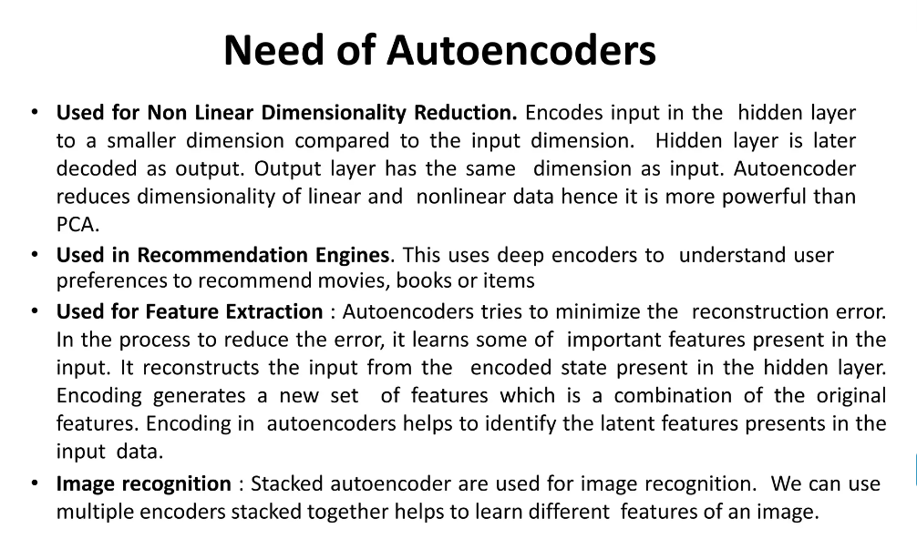

Slide 32
Types
There are, basically, 7 types of autoencoders:
Denoising autoencoder
Sparse Autoencoder
Deep Autoencoder
Contractive Autoencoder
Undercomplete Autoencoder
Convolutional Autoencoder
Variational Autoencoder

Slide 33
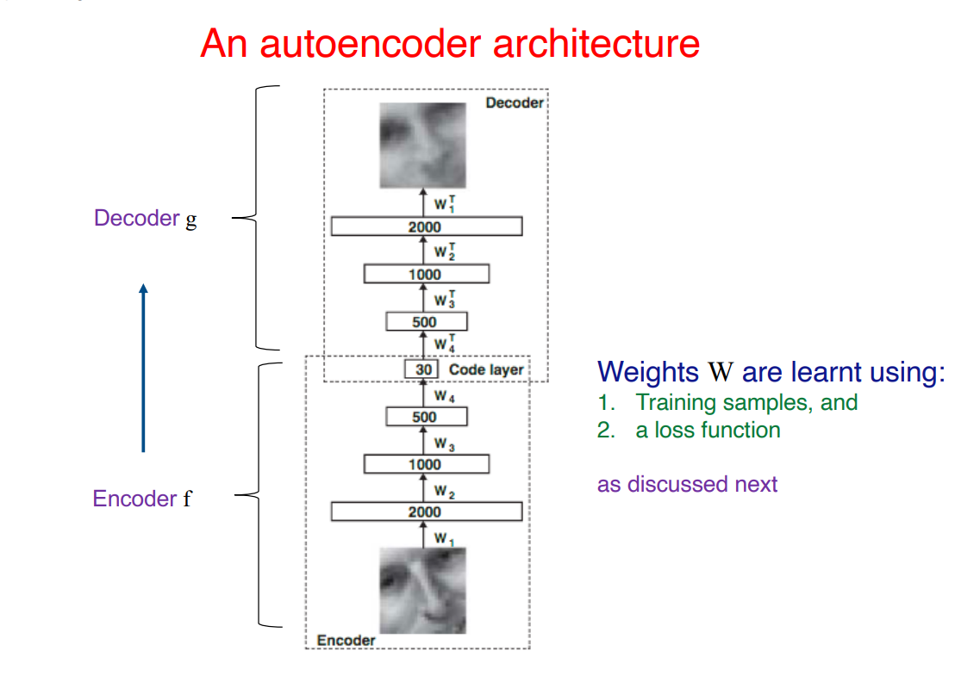

Slide 34
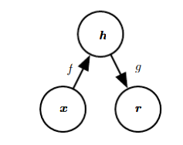
Undercomplete Autoencoders
→The general structure of an autoencoder,
** mapping an input x to an output (called reconstruction) r through an internal representation or code h.
→The autoencoder has : the encoder f (mapping x to h) and the decoder g (mapping h to r).
→Copying the input to the output may sound useless, but we are typically not interested in the output of the decoder.
→Instead, we hope that training the autoencoder to perform the input copying task will result in ‘h’ taking on useful properties.
→One way to obtain useful features from the autoencoder is to constrain ‘ h’ to have a smaller dimension than x.
→An autoencoder whose code dimension is less than the input dimension is called undercomplete.
→ Learning an undercomplete representation forces the autoencoder to capture the most salient features of the training data.

Slide 35
. The network may be viewed as consisting of two parts: an encoder function h = f (x) and a decoder that produces a reconstruction r = g(h).
The learning process is described simply as minimizing a loss function L(x, g(f(x)))
  where L is a loss function penalizing g(f (x)) for being dissimilar from x, such as the mean squared error.

Slide 36
The objective of undercomplete autoencoder is to capture the most important features present in the data.
Undercomplete autoencoders have a smaller dimension for hidden layer compared to the input layer.
This helps to obtain important features from the data.
It minimizes the loss function by penalizing the g(f(x)) for being different from the input x.
Advantages-
Undercomplete autoencoders do not need any regularization as they maximize the probability of data rather than copying the input to the output.
Drawbacks-
Using an overparameterized model due to lack of sufficient training data can create overfitting.

Slide 37
When the decoder is linear and L is the mean squared error, an undercomplete autoencoder learns to span the same subspace as PCA.
In this case, an autoencoder trained to perform the copying task has learned the principal subspace of the training data as a side eﬀect.
The subspace spanned by the column vectors of the matrix , called the principal subspace

Slide 38
What is the principal component of a dataset?
Principal component analysis, or PCA, is a dimensionality reduction method that is often used to reduce the dimensionality of large data sets, by transforming a large set of variables into a smaller one that still contains most of the information in the large set.

Slide 39
Variational auto encoders
Indeed, once the autoencoder has been trained, we have both an encoder and a decoder but still no real way to produce any new content.
At first sight, we could be tempted to think that, if the latent space is regular enough (well “organized” by the encoder during the training process), we could take a point randomly from that latent space and decode it to get a new content.
The decoder would then act more or less like the generator of a Generative Adversarial Network.

Slide 40
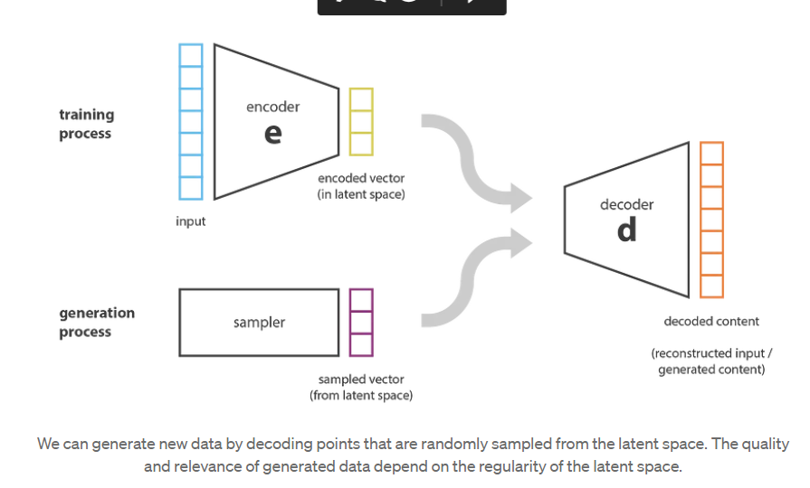

Slide 41
The regularity of the latent space for autoencoders is a difficult point that depends
  on the distribution of the data in the initial space,
  the dimension of the latent space
  and the architecture of the encoder.
  So, it is pretty difficult (if not impossible) to ensure, a priori, that the encoder will organize the latent space in a smart way compatible with the generative process we just described.

Slide 42
A variational autoencoder can be defined as being an autoencoder whose training is regularised to avoid overfitting and ensure that the latent space has good properties that enable generative process.
Instead of encoding an input as a single point, we encode it as a distribution over the latent space. The model is then trained as follows:
  first, the input is encoded as distribution over the latent space
  second, a point from the latent space is sampled from that distribution
  third, the sampled point is decoded and the reconstruction error can be computed
  finally, the reconstruction error is backpropagated through the network

Slide 43
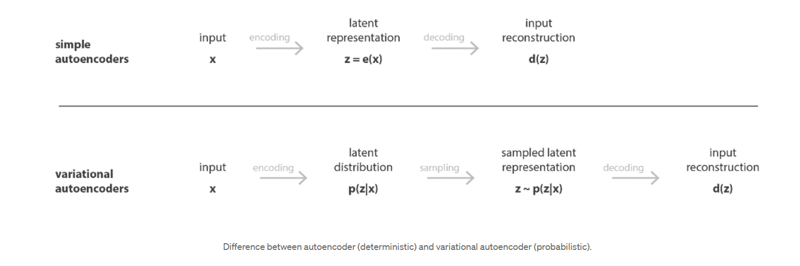
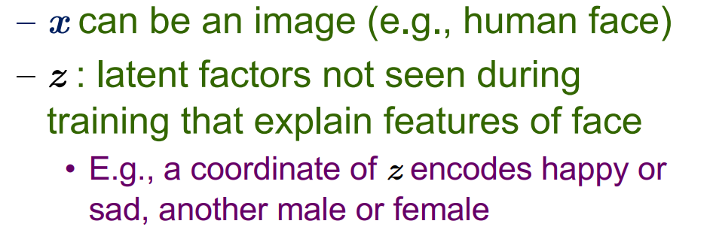

Slide 44
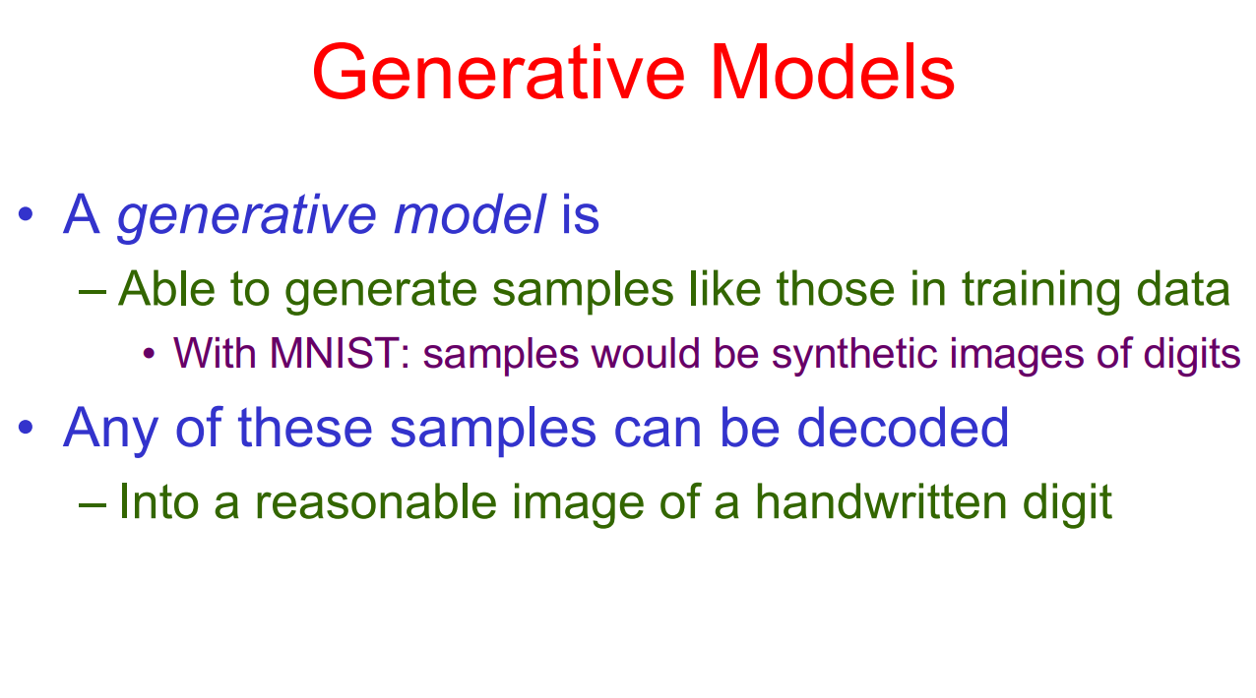

Slide 45
A variational autoencoder (VAE) provides a probabilistic manner for describing an observation in latent space.
Thus, rather than building an encoder which outputs a single value to describe each latent state attribute, we'll formulate our encoder to describe a probability distribution for each latent attribute.
An example, let's suppose we've trained an autoencoder model on a large dataset of faces with a encoding dimension of 6.
An ideal autoencoder will learn descriptive attributes of faces such as skin color, whether or not the person is wearing glasses, etc. in an attempt to describe an observation in some compressed representation.

Slide 46
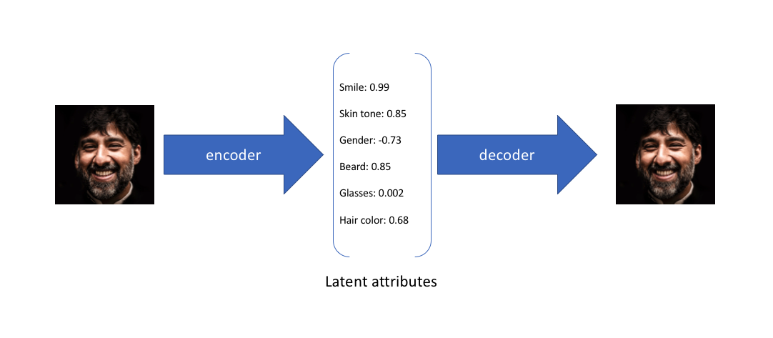

Slide 47
In the example above, we've described the input image in terms of its latent attributes using a single value to describe each attribute. However, we may prefer to represent each latent attribute as a range of possible values.
Using a variational autoencoder, we can describe latent attributes in probabilistic terms.

Slide 48
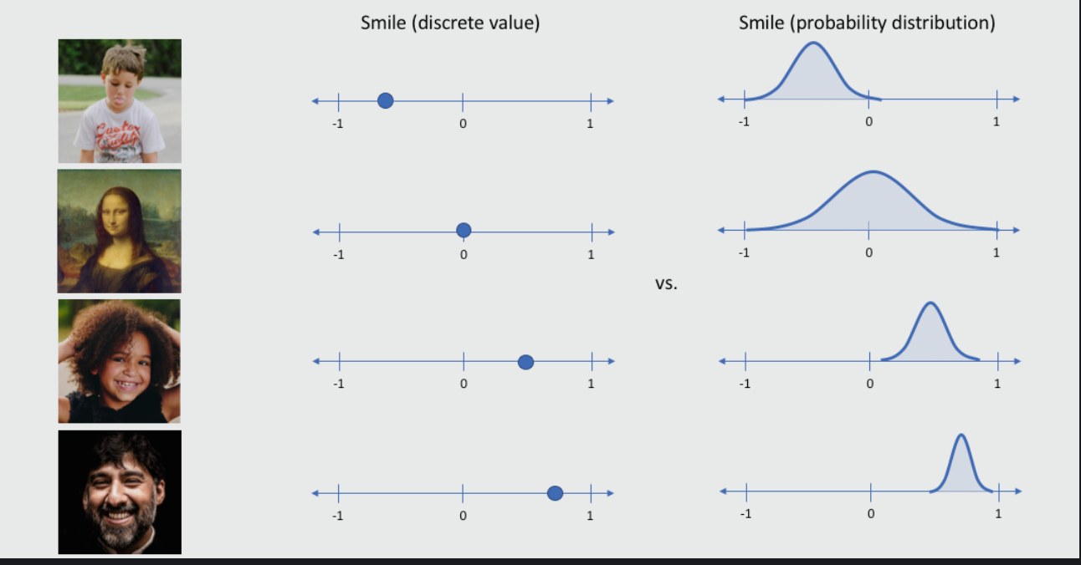

Slide 49
With this approach, we'll now represent each latent attribute for a given input as a probability distribution.
When decoding from the latent state, we'll randomly sample from each latent state distribution to generate a vector as input for our decoder model.

Slide 50
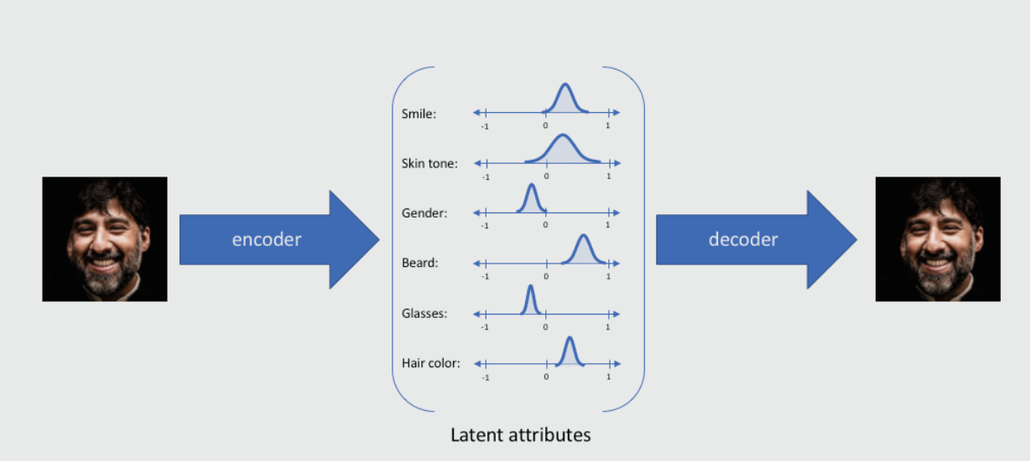

Slide 51
For variational autoencoders, the encoder model is sometimes referred to as the recognition model whereas the decoder model is sometimes referred to as the generative model.

Slide 52
By constructing our encoder model to output a range of possible values (a statistical distribution) from which we'll randomly sample to feed into our decoder model, we're essentially enforcing a continuous, smooth latent space representation.
For any sampling of the latent distributions, we're expecting our decoder model to be able to accurately reconstruct the input. Thus, values which are nearby to one another in latent space should correspond with very similar reconstructions.

Slide 53
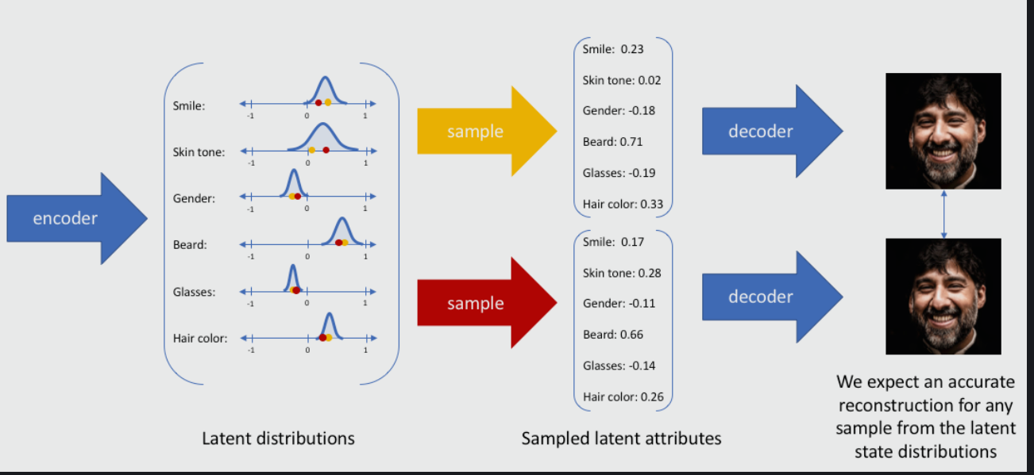

Slide 54
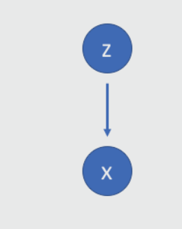
Suppose that there exists some hidden variable Z which generates an observation X.

Slide 55
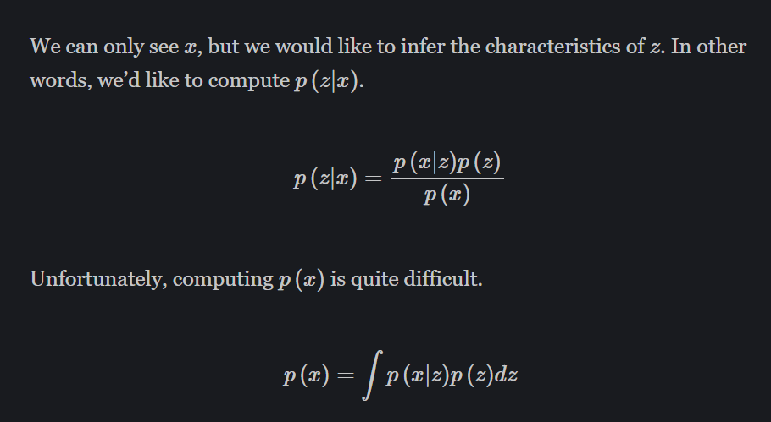

Slide 56
Variational autoencoder is different from autoencoder in a way such that it provides a statistic manner for describing the samples of the dataset in latent space. Therefore, in variational autoencoder, the encoder outputs a probability distribution in the bottleneck layer instead of a single output value.

Slide 57
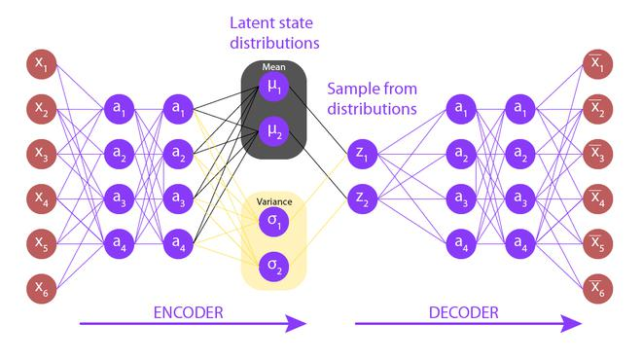

Slide 58
Denoising Autoencoder
Denoising autoencoders, as the name suggests, are autoencoders that remove noise from an image.
As opposed to autoencoders we’ve already covered, this is the first of its kind that does not have the input image as its ground truth.
In denoising autoencoders, we feed a noisy version of the image, where noise has been added via digital alterations. The noisy image is fed to the encoder-decoder architecture, and the output is compared with the ground truth image.

Slide 59
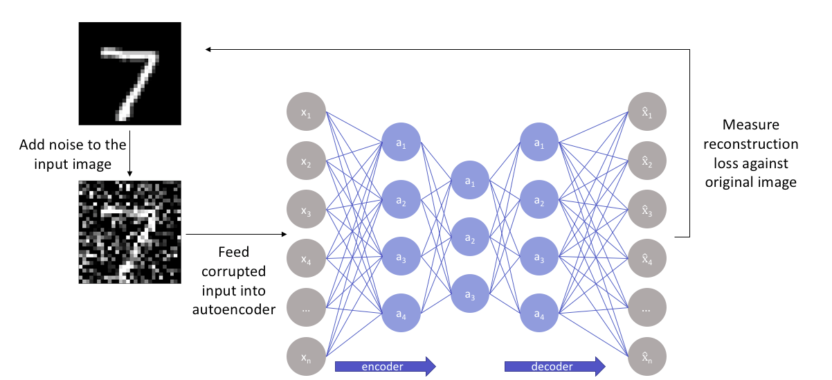

Slide 60
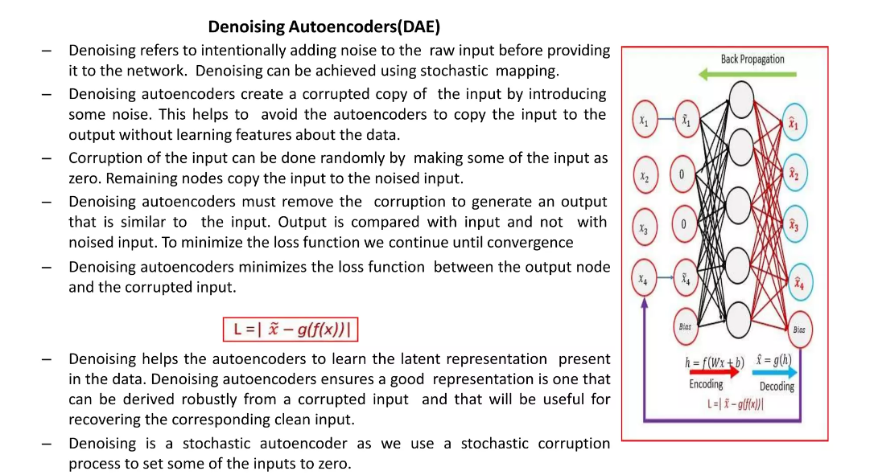

Slide 61
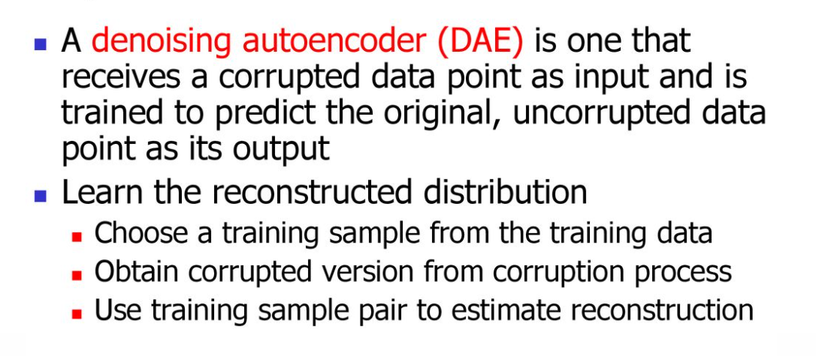

Slide 62
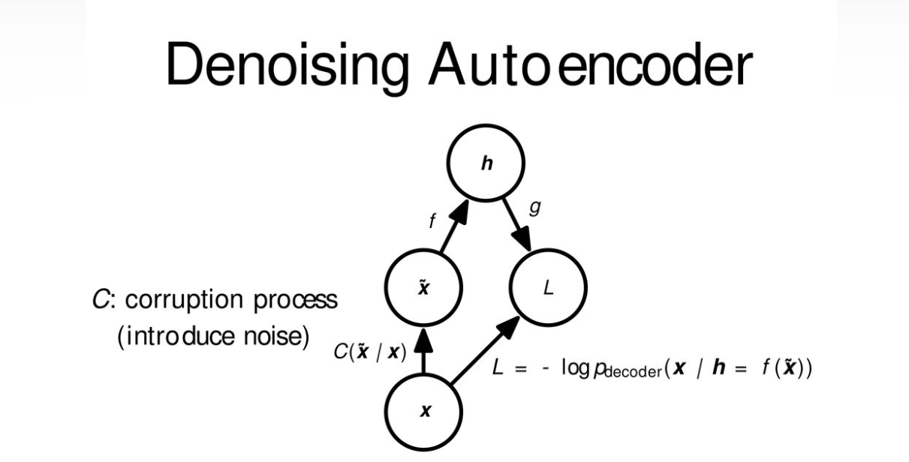

Slide 63
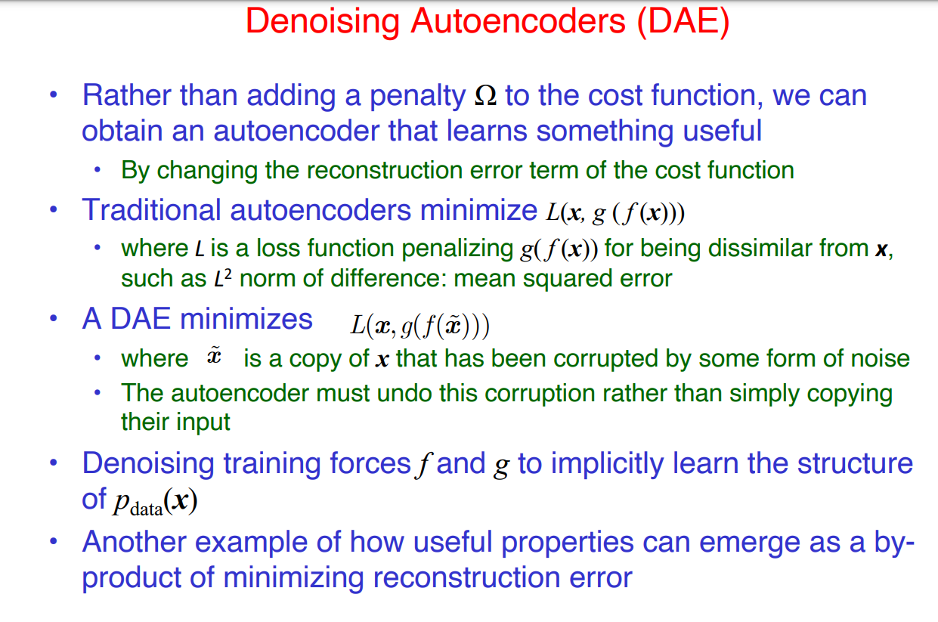

Slide 64
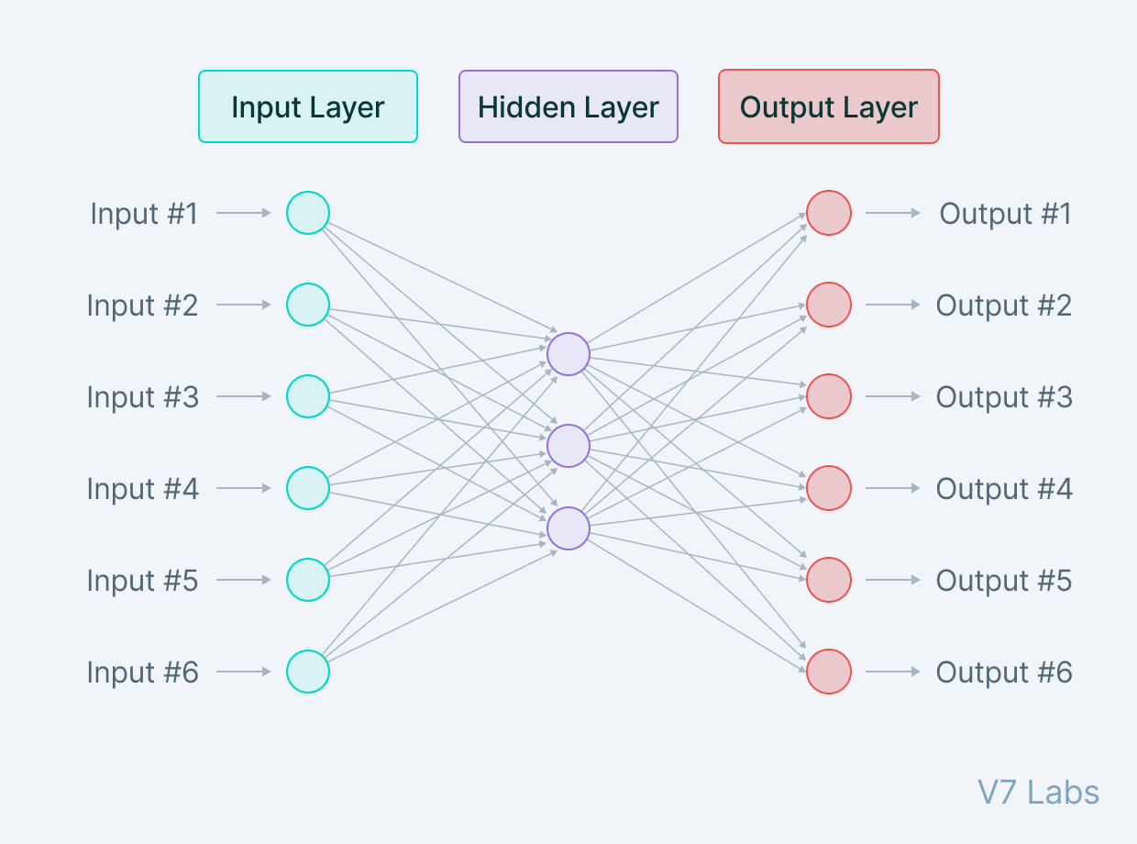
Sparse Autoencoder
Sparse autoencoders are similar to the undercomplete autoencoders in that they use the same image as input.

Slide 65
While undercomplete autoencoders are regulated and fine-tuned by regulating the size of the bottleneck, the sparse autoencoder is regulated by changing the number of nodes at each hidden layer.
Since it is not possible to design a neural network that has a flexible number of nodes at its hidden layers, sparse autoencoders work by penalizing the activation of some neurons in hidden layers.
In other words, the loss function has a term that calculates the number of neurons that have been activated and provides a penalty that is directly proportional to that.
This penalty, called the sparsity function, prevents the neural network from activating more neurons and serves as a regularizer.

Slide 66
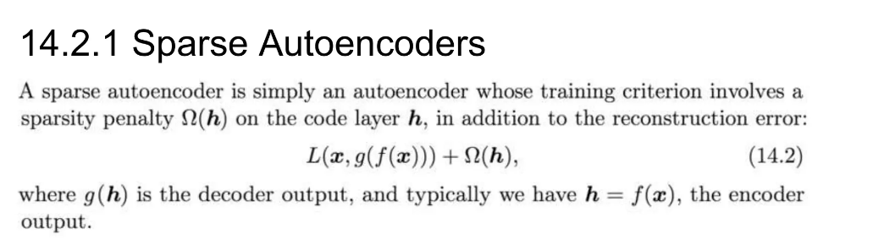

Slide 67
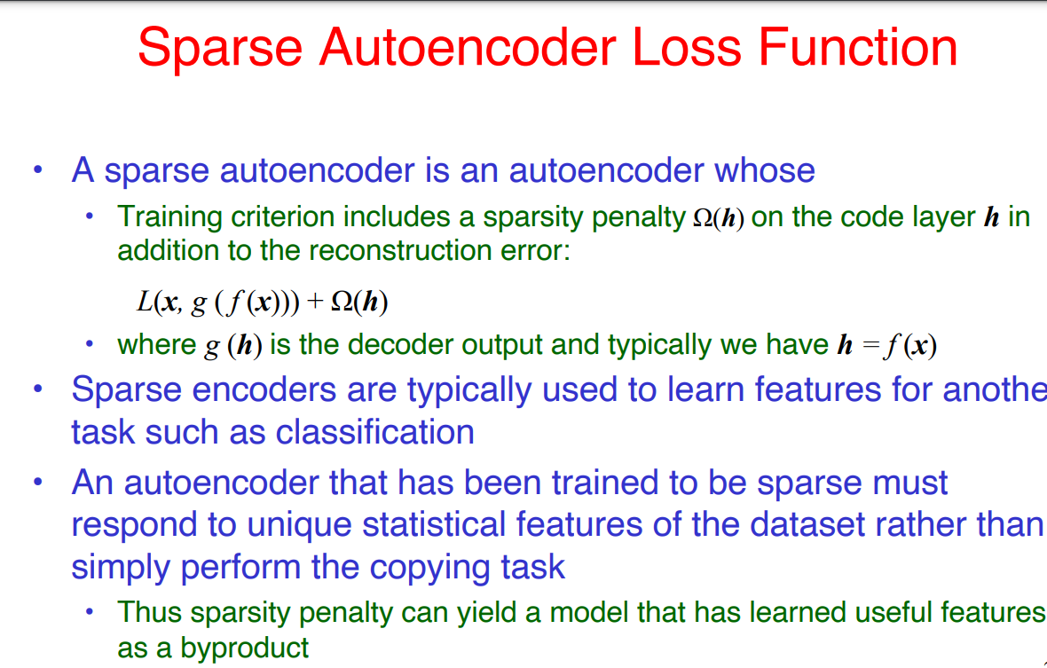

Slide 68
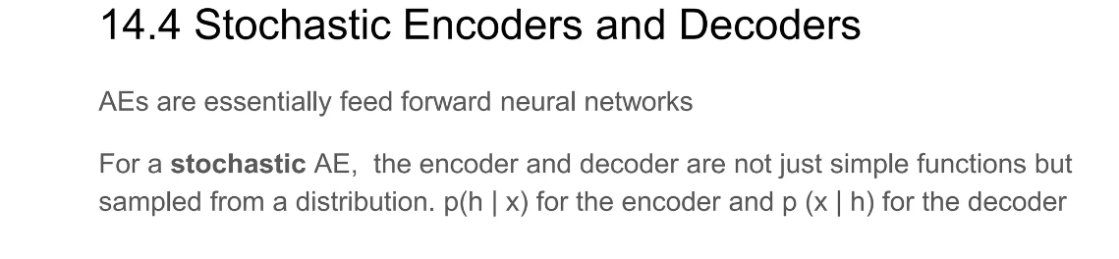

Slide 69
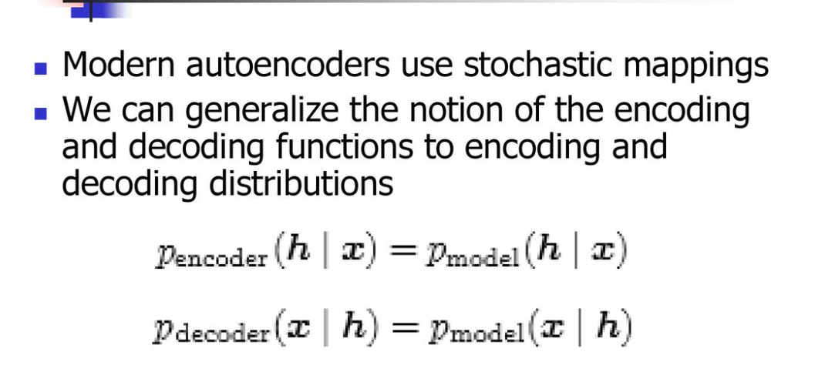

Slide 70
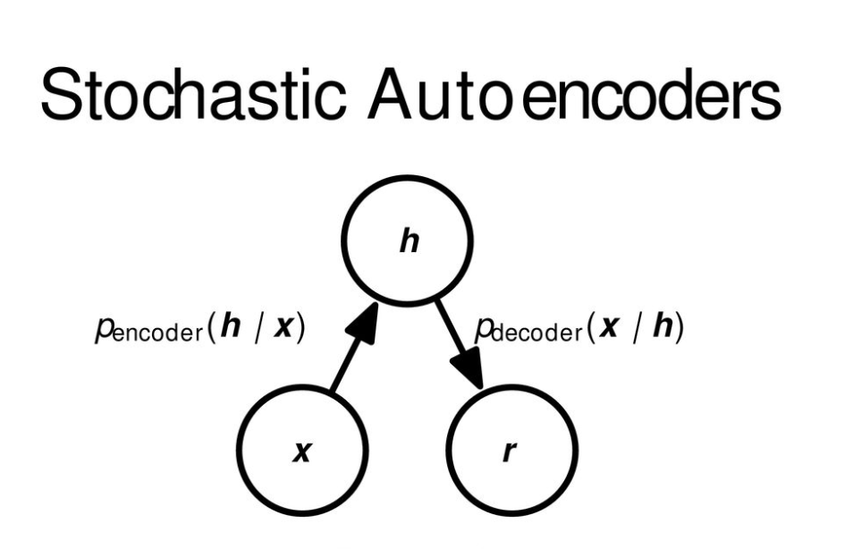

Slide 71
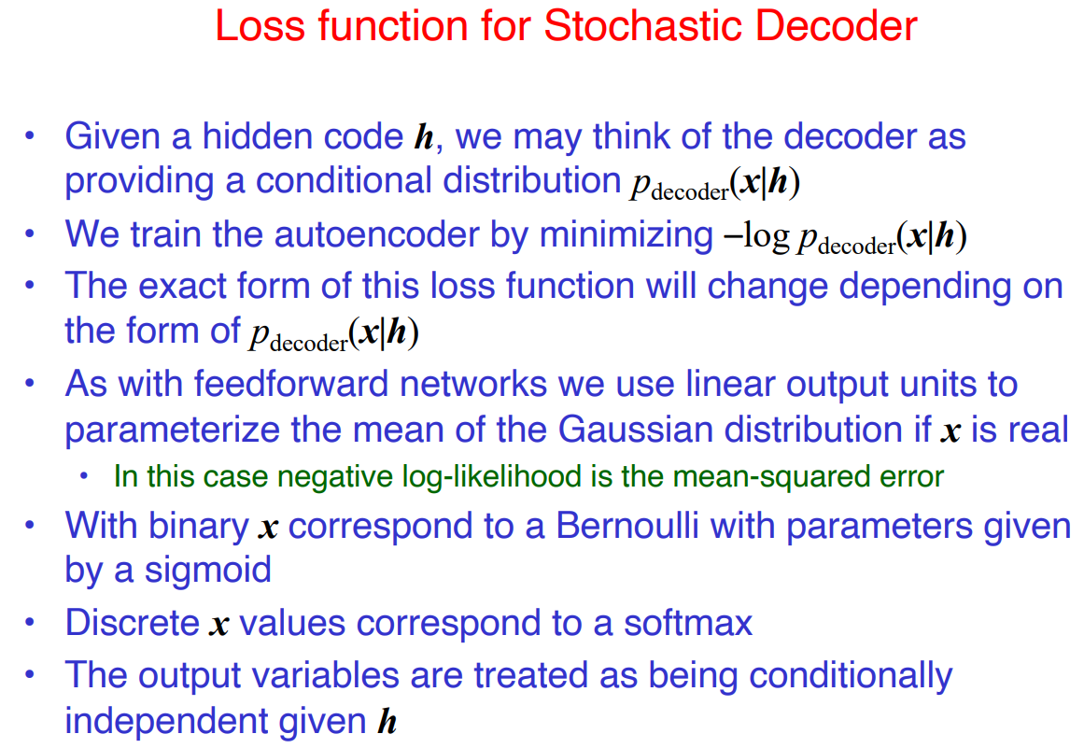

Slide 72
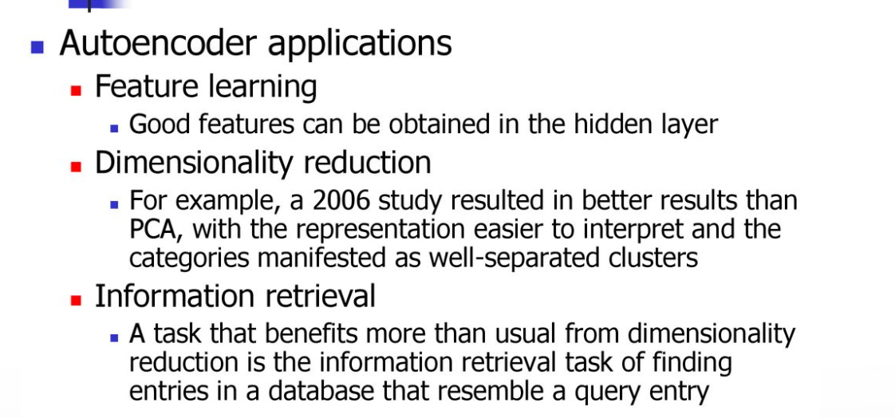
APPLICATIONS OF AUTOENCODER

Slide 73
1. Dimensionality reduction
Undercomplete autoencoders are those that are used for dimensionality reduction.
These can be used as a pre-processing step for dimensionality reduction as they can perform fast and accurate dimensionality reductions without losing much information.
Furthermore, while dimensionality reduction procedures like PCA can only perform linear dimensionality reductions, undercomplete autoencoders can perform large-scale non-linear dimensionality reductions.

Slide 74
2. Image denoising
Autoencoders like the denoising autoencoder can be used for performing efficient and highly accurate image denoising.
Unlike traditional methods of denoising, autoencoders do not search for noise, they extract the image from the noisy data that has been fed to them via learning a representation of it. The representation is then decompressed to form a noise-free image.
Denoising autoencoders thus can denoise complex images that cannot be denoised via traditional methods.

Slide 75
3. Generation of image and time series data
Variational Autoencoders can be used to generate both image and time series data.
The parameterized distribution at the bottleneck of the autoencoder can be randomly sampled to generate discrete values for latent attributes, which can then be forwarded to the decoder,leading to generation of image data. VAEs can also be used to model time series data like music.

Slide 76
4. Anomaly detection
Undercomplete autoencoders can also be used for anomaly detection.
For example—consider an autoencoder that has been trained on a specific dataset P. For any image sampled for the training dataset, the autoencoder is bound to give a low reconstruction loss and is supposed to reconstruct the image as is.
For any image which is not present in the training dataset, however, the autoencoder cannot perform the reconstruction, as the latent attributes are not adapted for the specific image that has never been seen by the network.
As a result, the outlier image gives off a very high reconstruction loss and can easily be identified as an anomaly with the help of a proper threshold.

Slide 77
4). Feature Extraction
Encoding part of Autoencoders helps to learn important hidden features present in the input data, in the process to reduce the reconstruction error. During encoding, a new set of combination of original features is generated.
5). Image Generation
There is a type of Autoencoder, named Variational Autoencoder(VAE), this type of autoencoders are Generative Model, used to generate images.

Slide 78
6). Sequence to Sequence Prediction
The Encoder-Decoder Model that can capture temporal structure, such as LSTMs-based autoencoders, can be used to address Machine Translation problems.
This can be used to:
  predict the next frame of a video
  generate fake videos

Slide 79
7). Recommendation Systems
Deep Autoencoders can be used to understand user preferences to recommend movies, books or other items. Consider the case of YouTube, the idea is:
the input data is the clustering of similar users based on interests
interests of users are denoted by videos watched, watch time for each, interactions (like commenting) with the video
above data is captured by clustering content
Encoder part will capture the interests of the user
Decoder part will try to project the interests on two parts:
  existing unseen content
  new content from content creators

